Slide 1


Slide 2
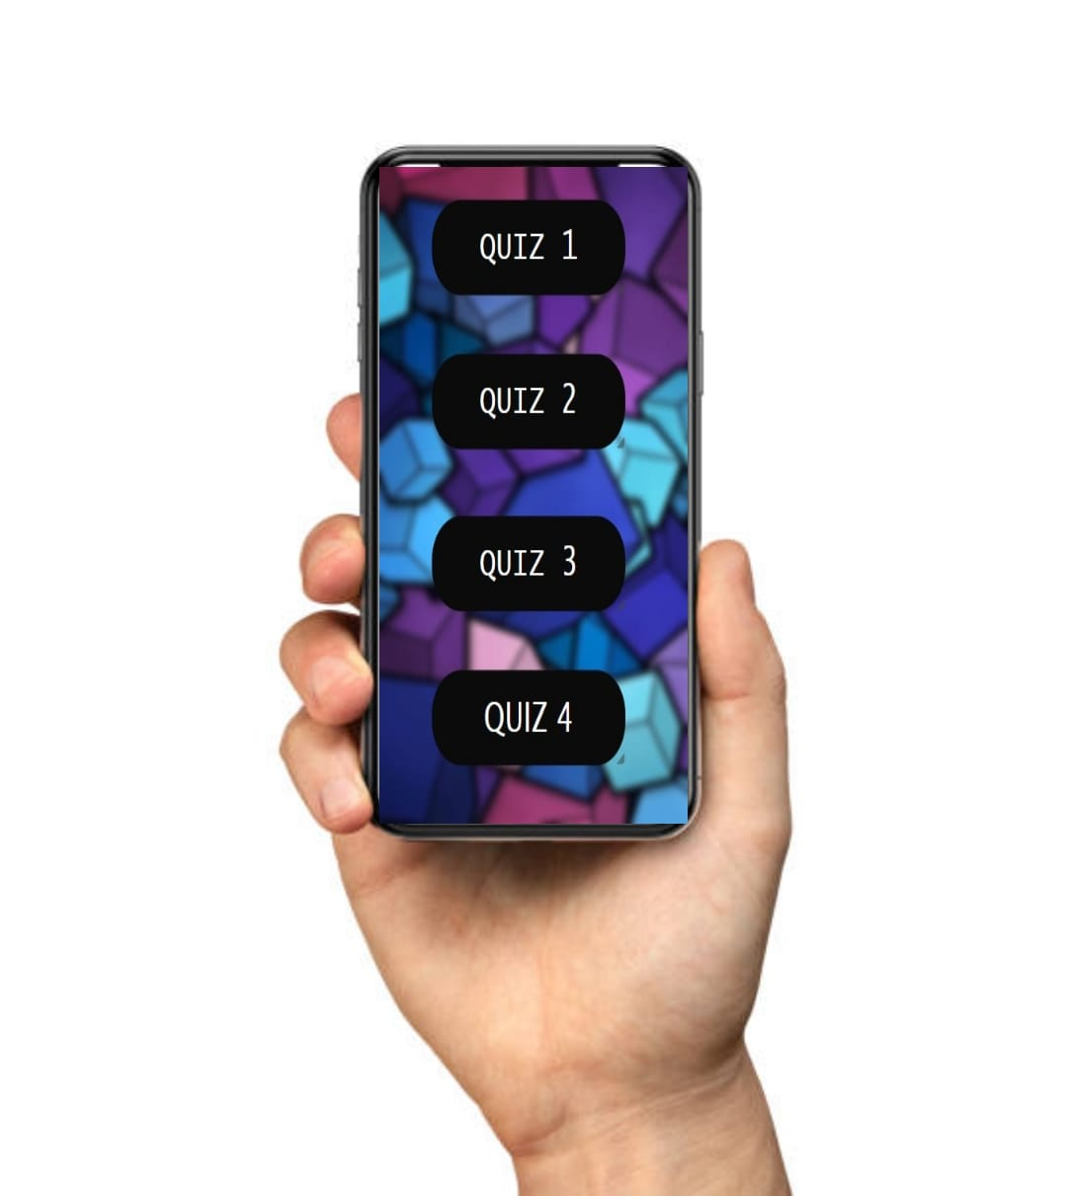
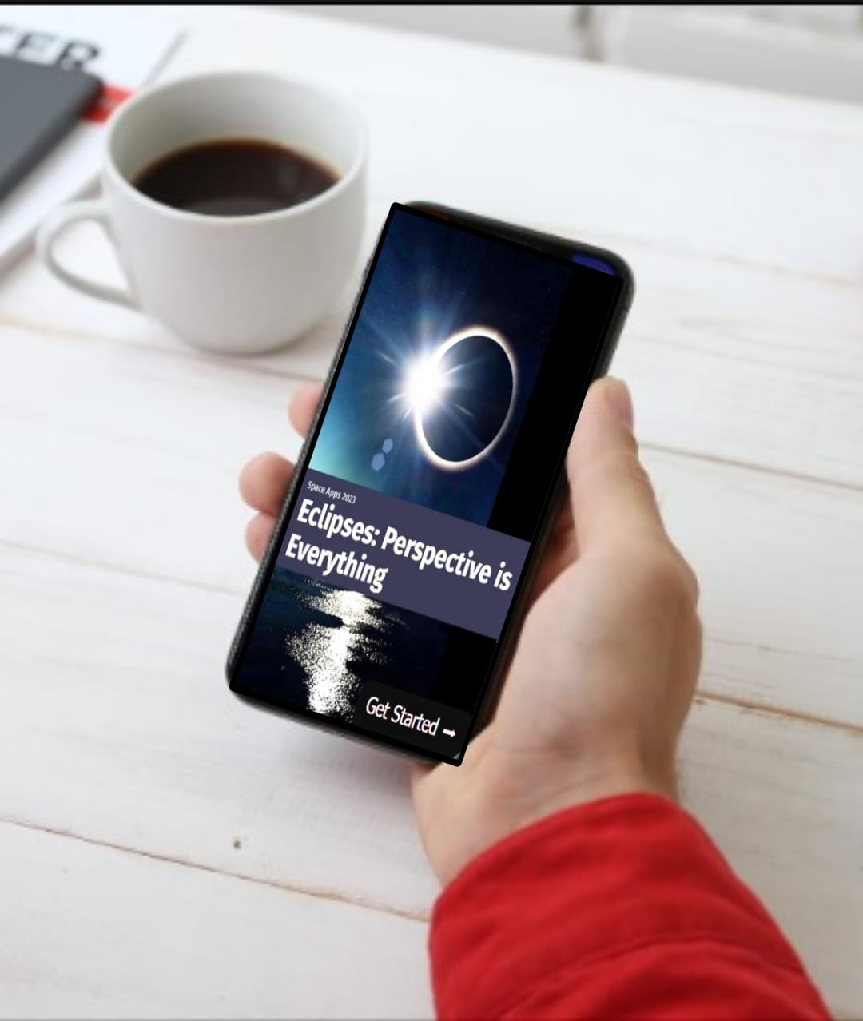
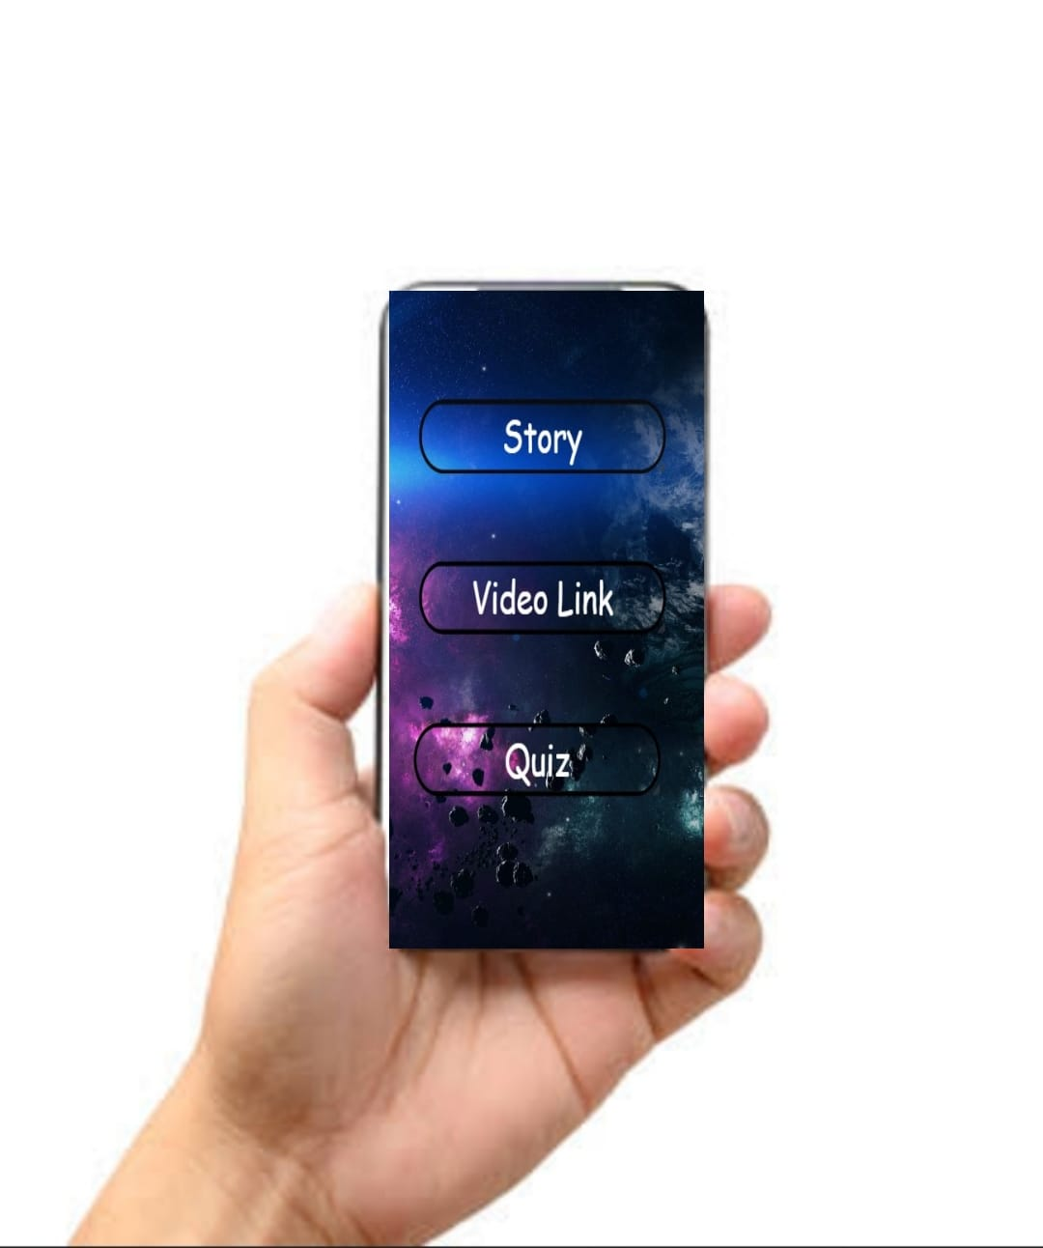
OUR APPLICATION
LINK …

Slide 3
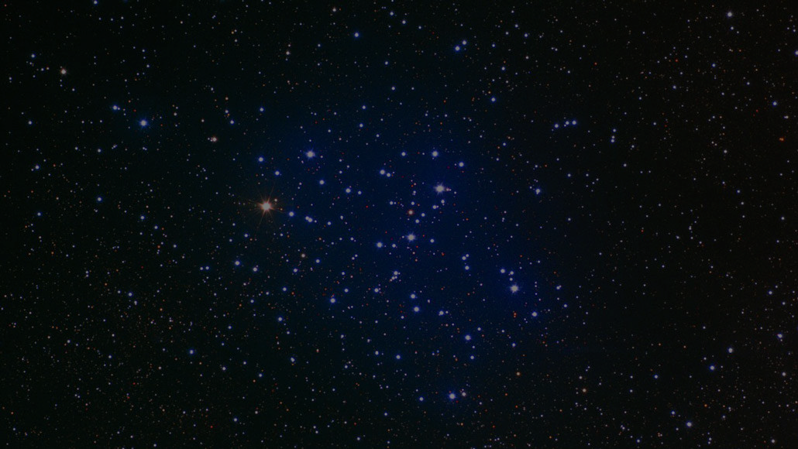
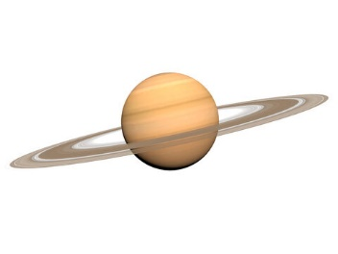
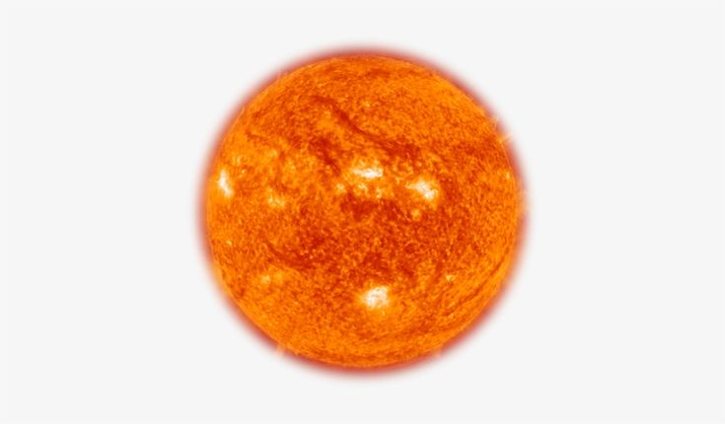
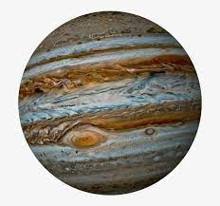
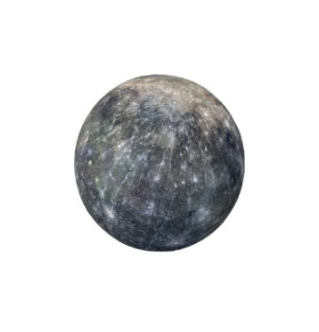
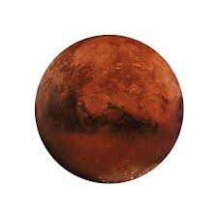

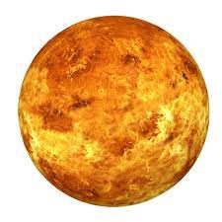
Eclipses: Perspective is Everything

Slide 4
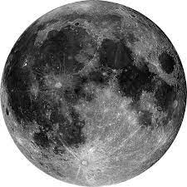


What causes the Sun, Moon, and Earth to align?
The alignment of the Sun, Moon, and Earth
occurs because of the gravitational forces at play.
The Moon orbits Earth, and Earth orbits the Sun
. Occasionally, the positions of these celestial
bodies align in such a way that one body casts a
shadow on another, leading to eclipses.The
alignment of the Sun, Moon, and Earth occurs
during certain celestial events like solar and lunar
eclipses. A solar eclipse happens when the Moon
moves between the Earth and the Sun, casting a
shadow on Earth as they align. A lunar eclipse
occurs when the Earth passes between the Sun
and the Moon, causing the Earth's shadow to be
cast on the Moon. These alignments are not
frequent because the orbits of the Moon and Earth
are slightly inclined relative to each other, leading
to eclipses occurring only during specific times in
their respective orbits.

Slide 5

What is Eclipse?

Slide 6
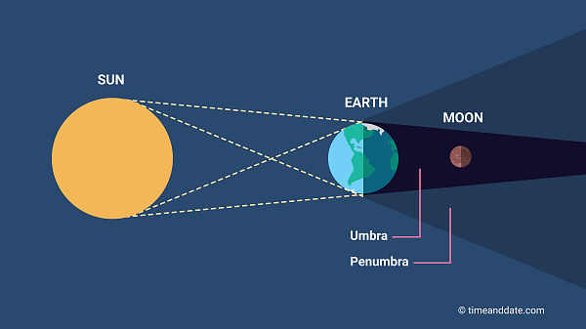
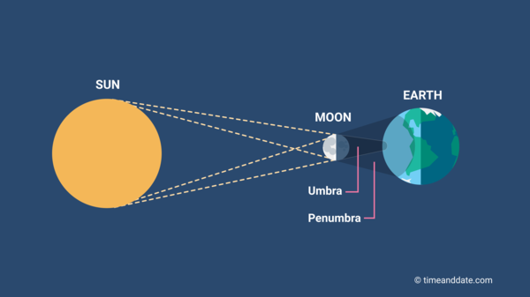
Lunar Eclipse
Solar Eclipse
Click For More
Click For More
NEXT

Slide 7
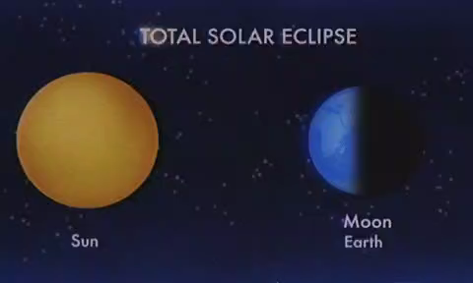

Slide 8
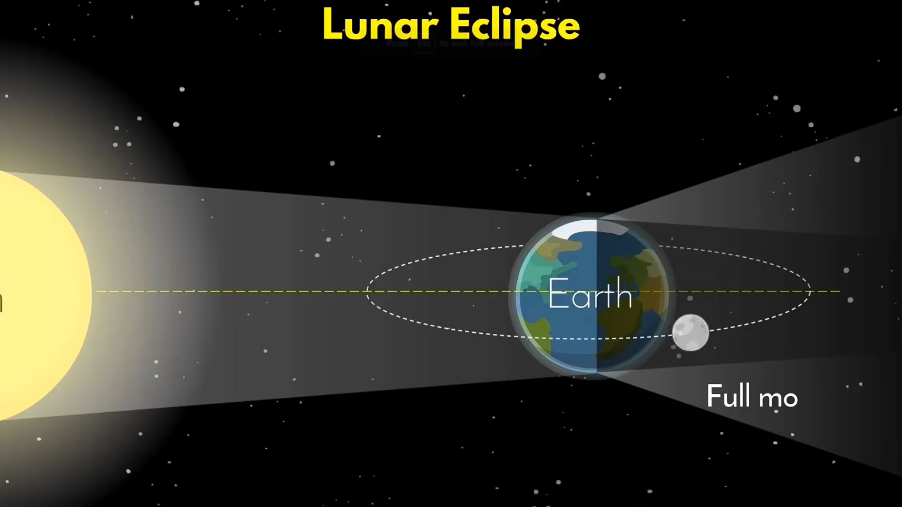

Slide 9

LET’s RECALL !!
CLICK ME
QUIZ 1

Slide 10
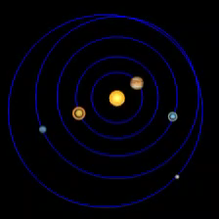
How often do eclipses occur?
Eclipses occur periodically but not at every new or full moon. Solar eclipses happen roughly every 18 months somewhere on Earth, while lunar eclipses occur about twice a year.

Slide 11

12
11
1
What is an eclipse season, and why do they occur approximately every six months (or twice a year)?
An eclipse season is one of only two periods during each year when the Sun, Moon, and Earth are aligned, allowing eclipses to occur. Eclipse seasons occur approximately every six months due to the tilt of the Moon's orbit relative to Earth's orbit around the Sun. These seasons provide windows of opportunity for eclipses because they are times when the Moon's path intersects with Earth's orbital plane (the ecliptic), making eclipses more likely. Each season lasts about 35 days and repeats just short of every six months. In addition to inspiring artists and musicians, eclipses have driven numerous scientific discoveries.
10
2
9
3
8
4
7
5
6

Slide 12
LET’s RECALL !!
CLICK ME
QUIZ 2

Slide 13


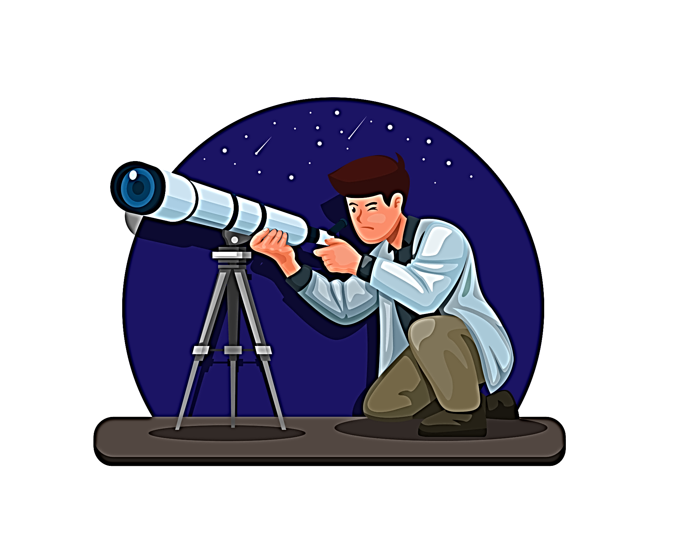
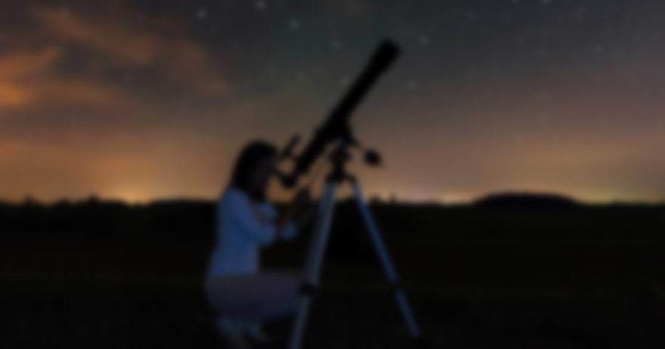
How do scientists know when and where eclipses will occur?
Scientists can predict eclipses using mathematical models and astronomical calculations. By knowing the orbits of the Moon and Earth, astronomers can forecast eclipse events, including their timing, duration, and geographic visibility.

Slide 14
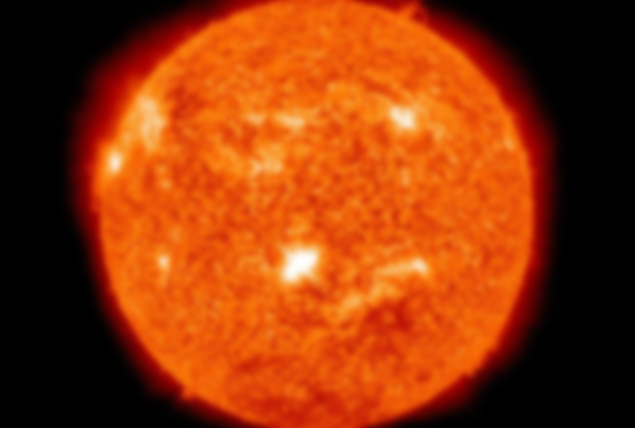
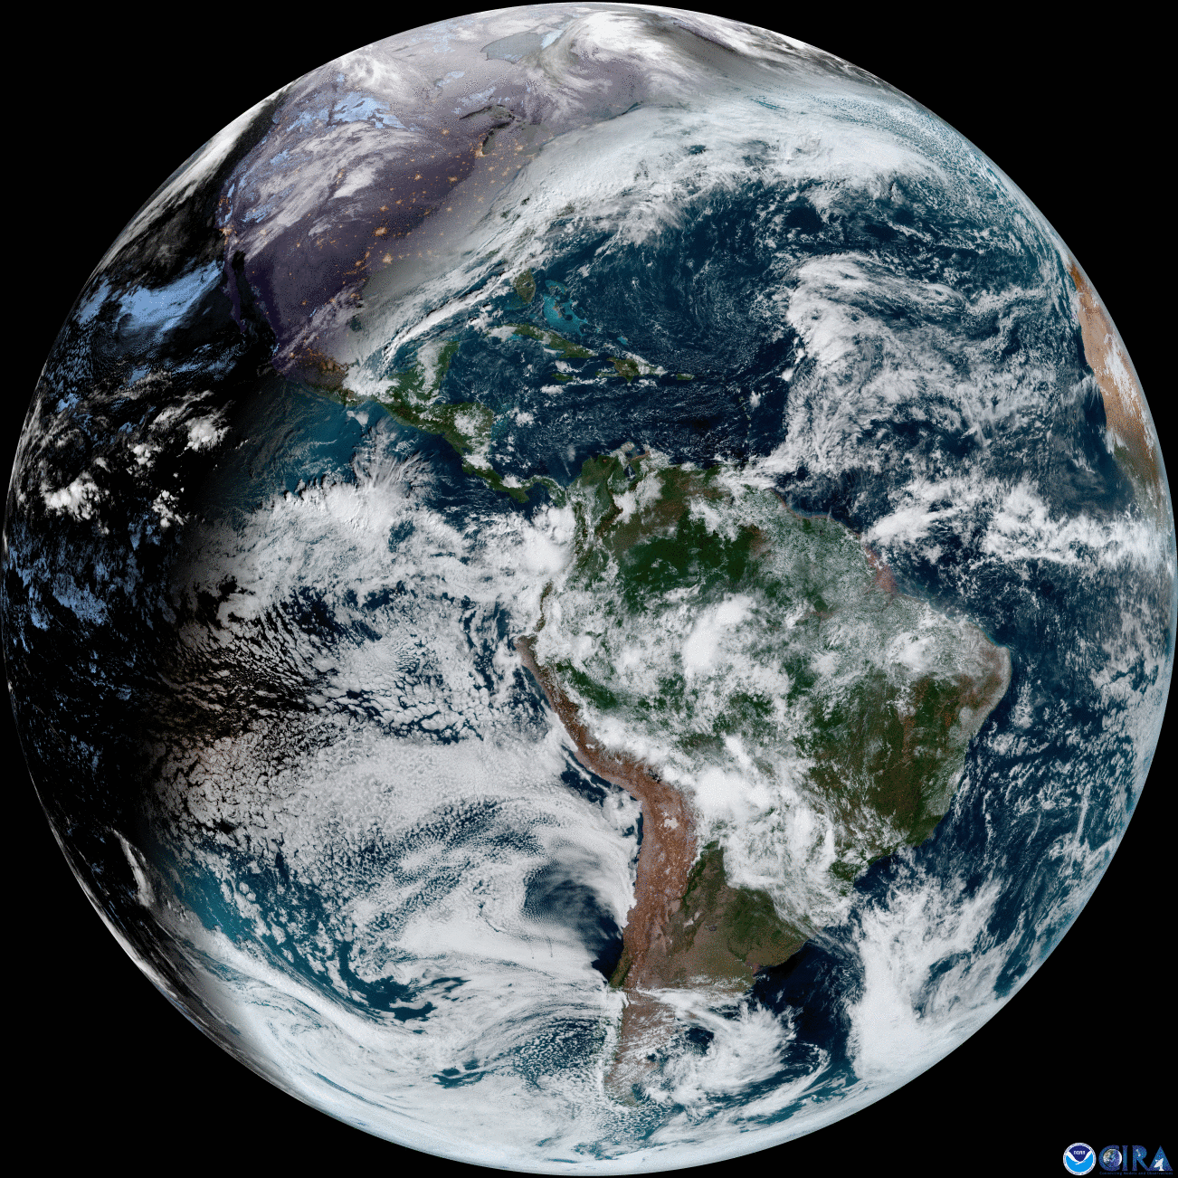
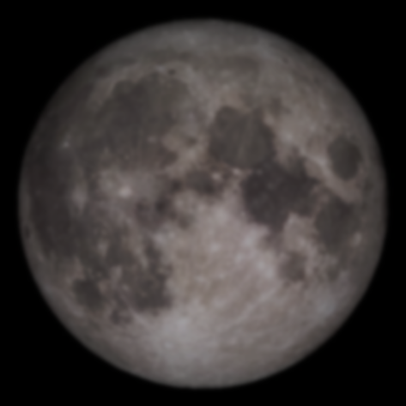
Why do only some people on Earth see an eclipse at a given time?
During an eclipse, only a specific region on Earth can see the phenomenon because of the finite size of the Moon's shadow. This shadow's path is relatively narrow, and only observers within it witness the eclipse. People outside this path see either a partial eclipse or no eclipse at all.

Slide 15
LET’s RECALL !!
CLICK ME
QUIZ 3

Slide 16
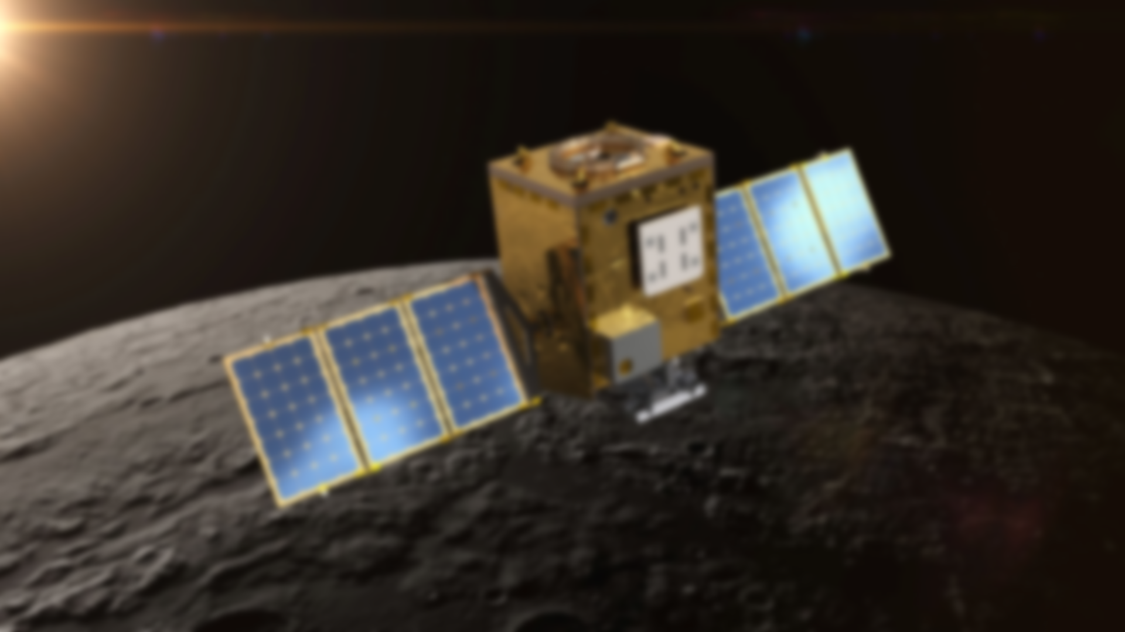
Research on eclipses
NASA often conducts special missions and observations during solar eclipses to study the Sun's outer atmosphere, the corona.
The Parker Solar Probe, launched by NASA, aims to study the Sun up close and gather data during solar eclipses.
NASA's Solar Dynamics Observatory (SDO) continuously observes the Sun to understand solar activity and its impact on Earth.
The Eclipse Ballooning Project involves launching high-altitude balloons equipped with scientific instruments during eclipses to collect data.
Lunar Eclipses:
NASA conducts lunar observations to study the Earth's shadow on the Moon during lunar eclipses.
Research focuses on understanding Earth's atmosphere by analyzing the colors and brightness of the lunar eclipse.
NASA's Lunar Reconnaissance Orbiter (LRO) has provided detailed images of the Moon, including features observed during lunar eclipses.
Public Outreach and Education:
NASA actively engages in public outreach and educational efforts during eclipses, providing resources, webcasts, and live coverage to increase awareness and scientific understanding.
NASA's website and social media platforms often feature articles, videos, and interactive tools related to eclipses.

Slide 17
LET’s RECALL !!
CLICK ME
QUIZ 4

